Slide 1
Insights Into Breast Cancer from Deconvolution of Bulk RNA Sequencing Data
By:
Yves Greatti
Reem Abu-Shamma
Lingzhu Shen

Slide 2
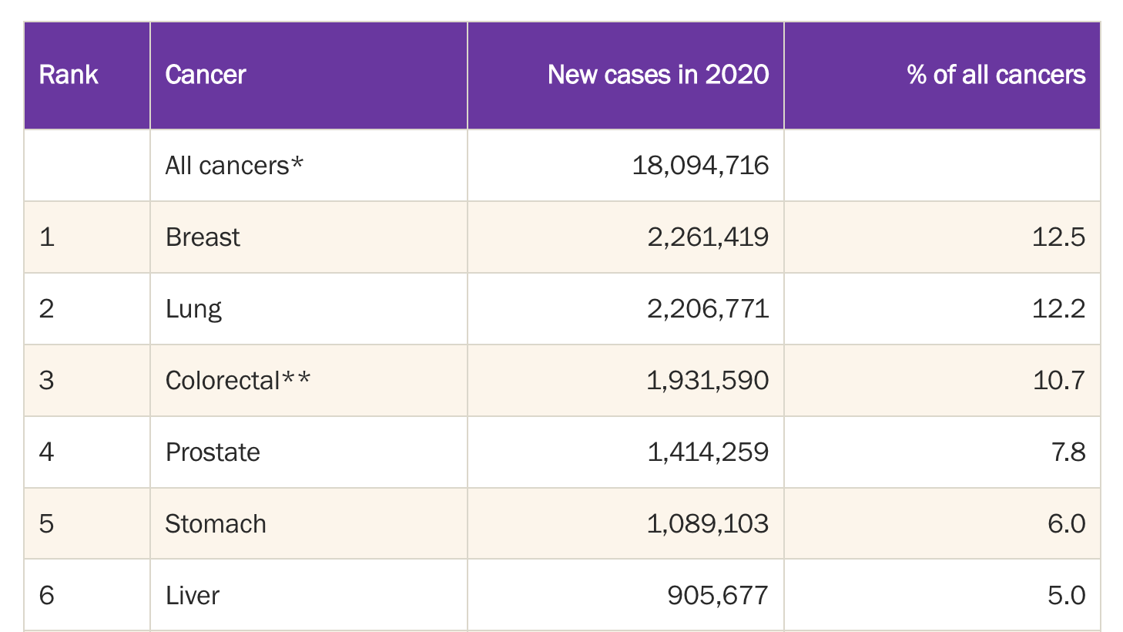
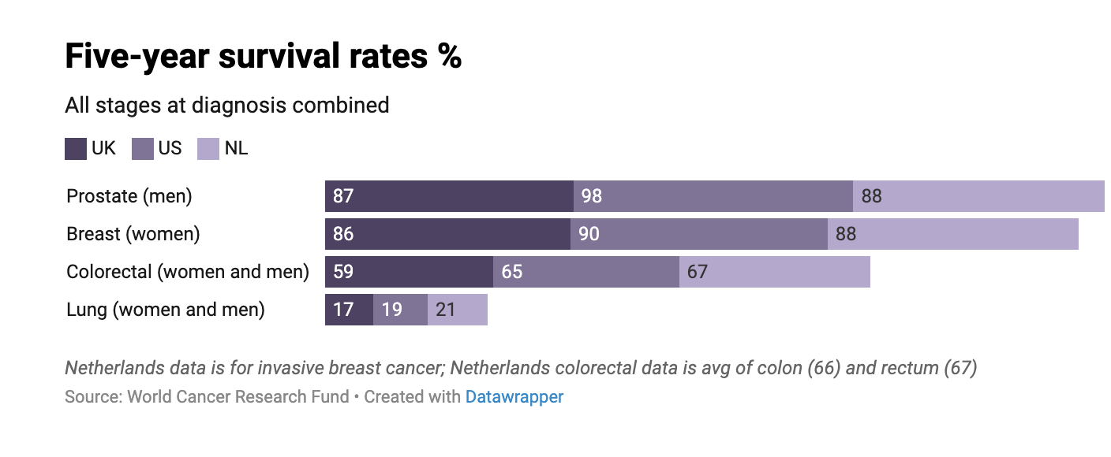
Why is Breast Cancer such a problem?
1st most common cancer in the world
[1]
Notes:
L; 30 secs
Triple-negative breast cancer (TNBC) or basal-like breast cancer: estrogen receptor (ER) (-) and progesterone receptors (PR) (-), human epidermal growth factor receptor 2 (HER2) (-) expression, is more prevalent in individuals with a BRCA1 mutation, and is the most aggressive subtype.
Luminal A breast cancer: ER (+) and PR (+), HER2 (-) and has low levels of the protein Ki-67.
Luminal B breast cancer: ER (+) and HER2 (-), and either have high levels of Ki-67 or is PR (-)
HER2-enriched breast cancer: ER (-) , PR (-), and HER2 (+)

Slide 3
Bulk-RNA Seq Data Pros and Cons
Bulk RNA-seq data measures gene expression levels across all cells in a sample, regardless of cell type, and thus cannot distinguish between different cell types present in the sample.
Compared to single cell RNA-seq, acquisition of bulk RNA-seq data is easy
Bulk RNA-seq deconvolution is an important tool for understanding the cellular complexity of biological systems.
Bulk RNA-seq deconvolution can help researchers to identify cell type-specific biomarkers or drug targets, which can have important implications for the development of new therapies related to cancer.
Notes:
L

Slide 4
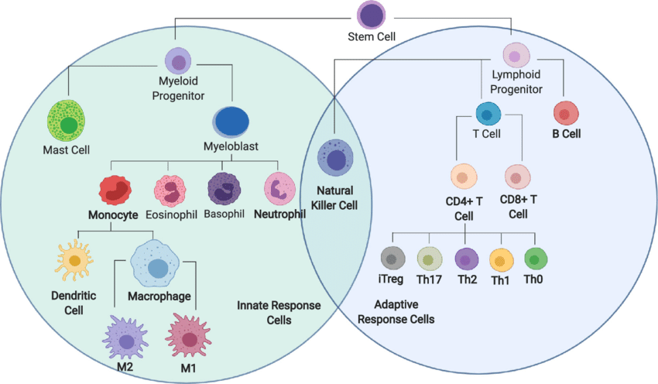
Immune cells
Notes:
Ideas/traisition from previous slides: bulk RNAseq data comes from several cell types which may include immune cells (interest of our project)
L; 10 secs

Slide 5
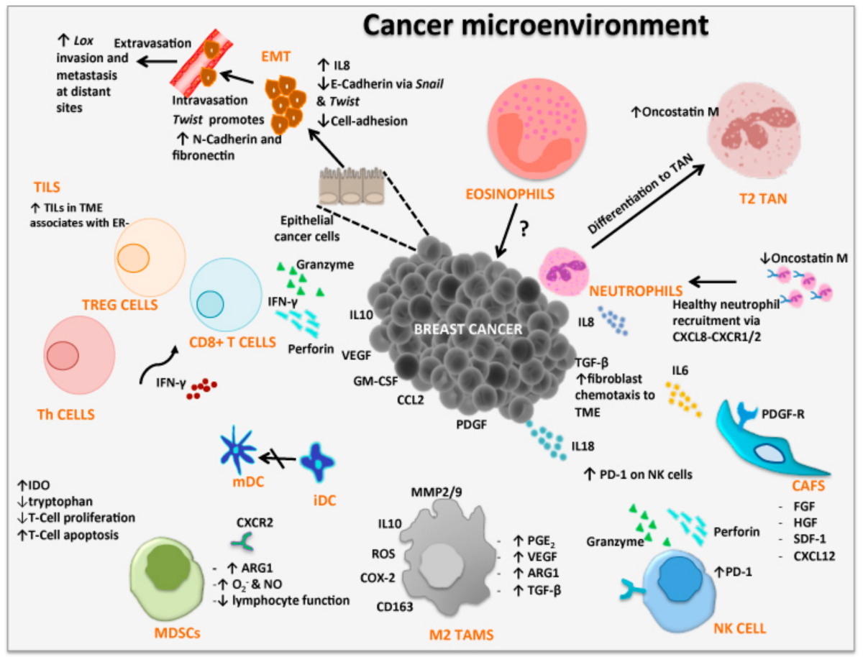
Immune cells play a dual role in breast cancer microenvironment
Notes:
L
Dual role of immune cells in TME; show immunosupression here (positive)
includes immune cells, signaling molecules, ECM and so on. Immune cells play a critical role in the tumor microenvironment, influencing the development, progression, and metastasis of tumors through the combined action of many cytokines
The fact that immune cells can behave as guardians (anti-tumour immunity) or as bystanders or supporters of the tumour (pro-tumour immunity) makes them a “double-edged sword” in the TME.

Slide 6
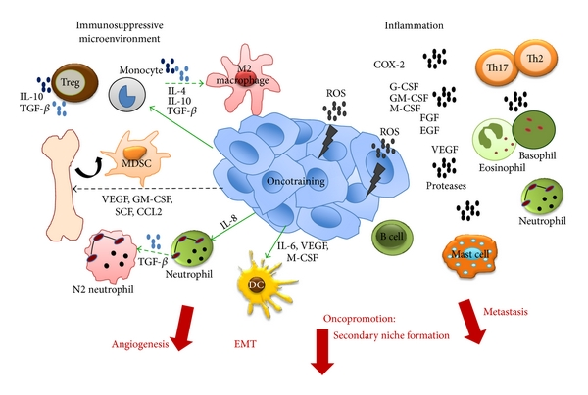
Pro-tumoral activities of the immune system
Notes:
L
contribute to inflammatory TME, thereby enhancing tumour progression
Almost all innate immune populations contribute to inflammation plus B cells and some T cells

Slide 7
Methodology Flowchart
Bulk RNA-seq data:
TCGA BRCA cohort
ScRNA-seq:
GSE176078 (Wu et al.); tumor
GSE161529 (Pal et al.); tumor and normal
Data Collection
And Processing
Deconvolution
Multi-subject Single-cell Deconvolution (MUSiC2)
Python package
Iterative algorithm
Appropriate weighting of genes cross-samples and cross-cell
Immune Cell
Impact Analysis
XGBoost regression model and SHAP
using ESTIMATE immune score
Pathway analysis with PROGENy (R package) and decoupler (Python package)
Survival analysis with Python lifelines and scikit-survival packages
Pathway Inference
Survival Analysis
Notes:
Y
Different R libraries to read the data and assemble together read counts with clinical information
Gene deduplication filtering and symbol conversion
Deconvolution using MUSiC: performance optimization
Immune cell impact evaluation using statistical methods and ml
Pathway Inference from deconvolution

Slide 8
Data Overview
Notes:
L

Slide 9
TCGA BRCA Cohort – Bulk RNA-seq
Normal Cohort (Control)
Tumor Cohort (Experimental)
113 cases
Age
Mean 57.33
Std. 14.58
Min. 30
Max 90
1,111 cases​
Age​
Mean 58.42​
Std. 13.21​
Min. 26​
Max 90​
Tumor Stage​
Stage I 16.8%​
Stage II 57.1%​
Stage III 23.1%​
Stage IV 3.1%​
BRCA Subtype​
Basal 17.4%​
Her2 8%​
LumA 50.9%​
LumB 20.1%​
Normal 3.7%​
Notes:
L
TCGA = The Cancer Genome Atlas
BRCA= breast cancer
Age distribution close
Normal = control
Tumor = experimental; Considered all together for this project (a preliminary investigation) in future can look at stage separately and subtype (outside scope of project)

Slide 10
ScRNA-seq Datasets
GSE161529: study from Pal et. Al.(2021).
52 patients, 430,000 cells and different breast cancer subtypes (4 TNBCs, 4 BRCA1 TNBCs, 6 HER+ tumors)
GSE176078: study from Wu et. Al.(2021).
26 primary tumors from three major subtypes of breast cancer (11 ER+, 5 HER2+, and 10 TNBC), 9 major cell types, 49 cell subtypes identified and normal tissue
Notes:
L
Same tissue type to deconvolute bulk RNA-seq using scRNA seq data as a reference
2 data sets? Coverage of more cell types

Slide 11
Cell Type Overview

Slide 12
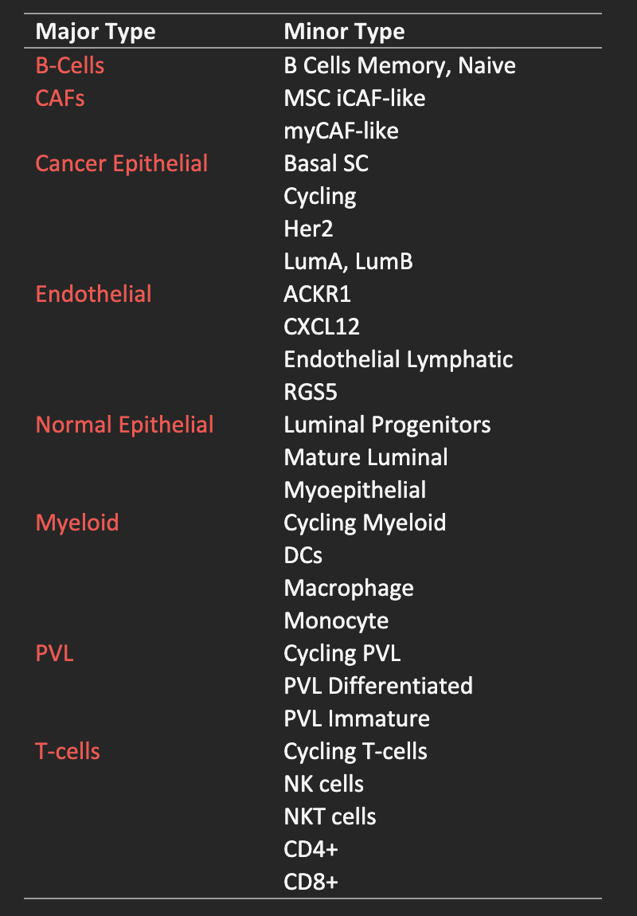
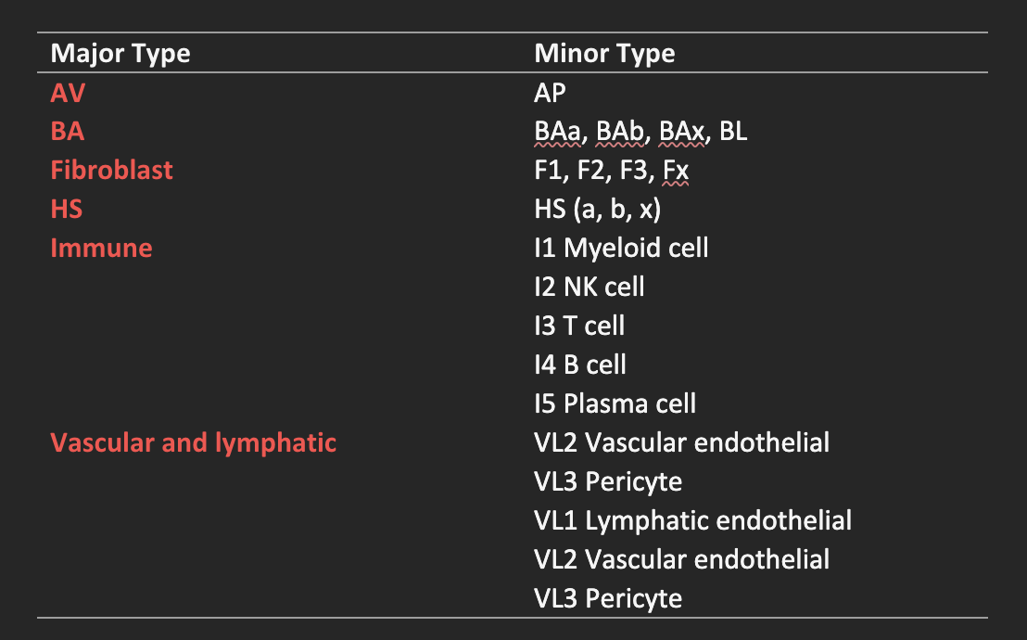
Multiple Cell Types Play a Role in the Disease
(Alveolar)
(Basal)
(Hormone Sensing )
Notes:
Y
Focus for this project is immune cells; but considered other cell types to give insight into some broader biological processes
10 major types and more than 50 subtypes

Slide 13
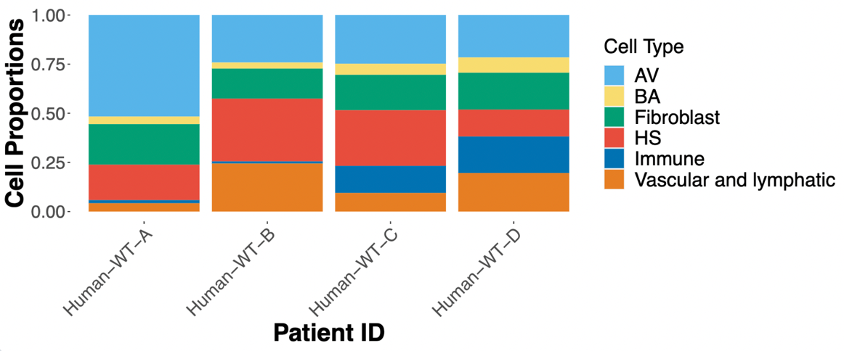
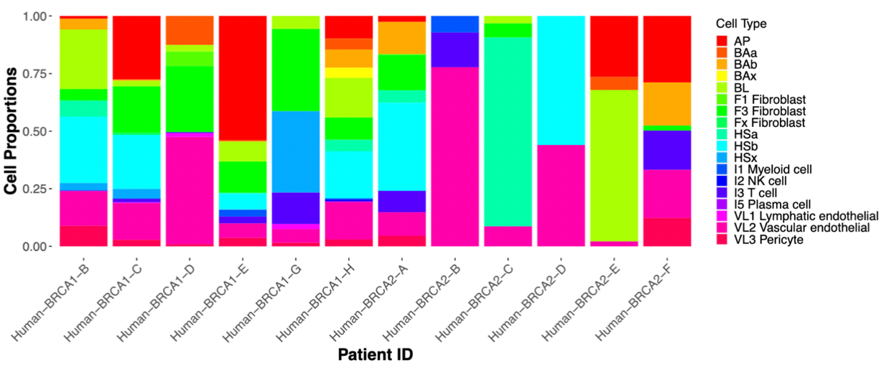
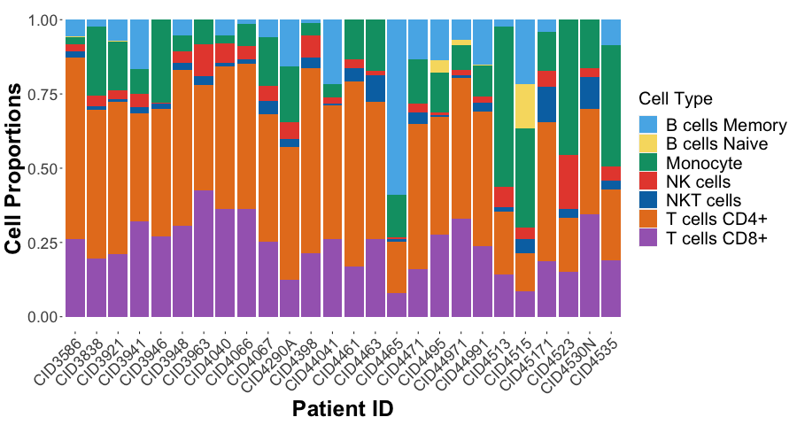
Datasets and cell types - Top: Normal cohort (GSE161529) - Middle: Tumor cohort (GSE161529) - Bottom: Tumor cohort (GSE176078)
Notes:
Y

Slide 14
Tools

Slide 15
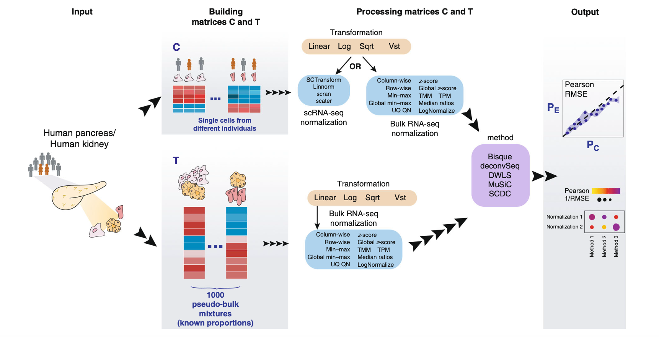
Workflow of Deconvolution Methods
Notes:
Y

Slide 16
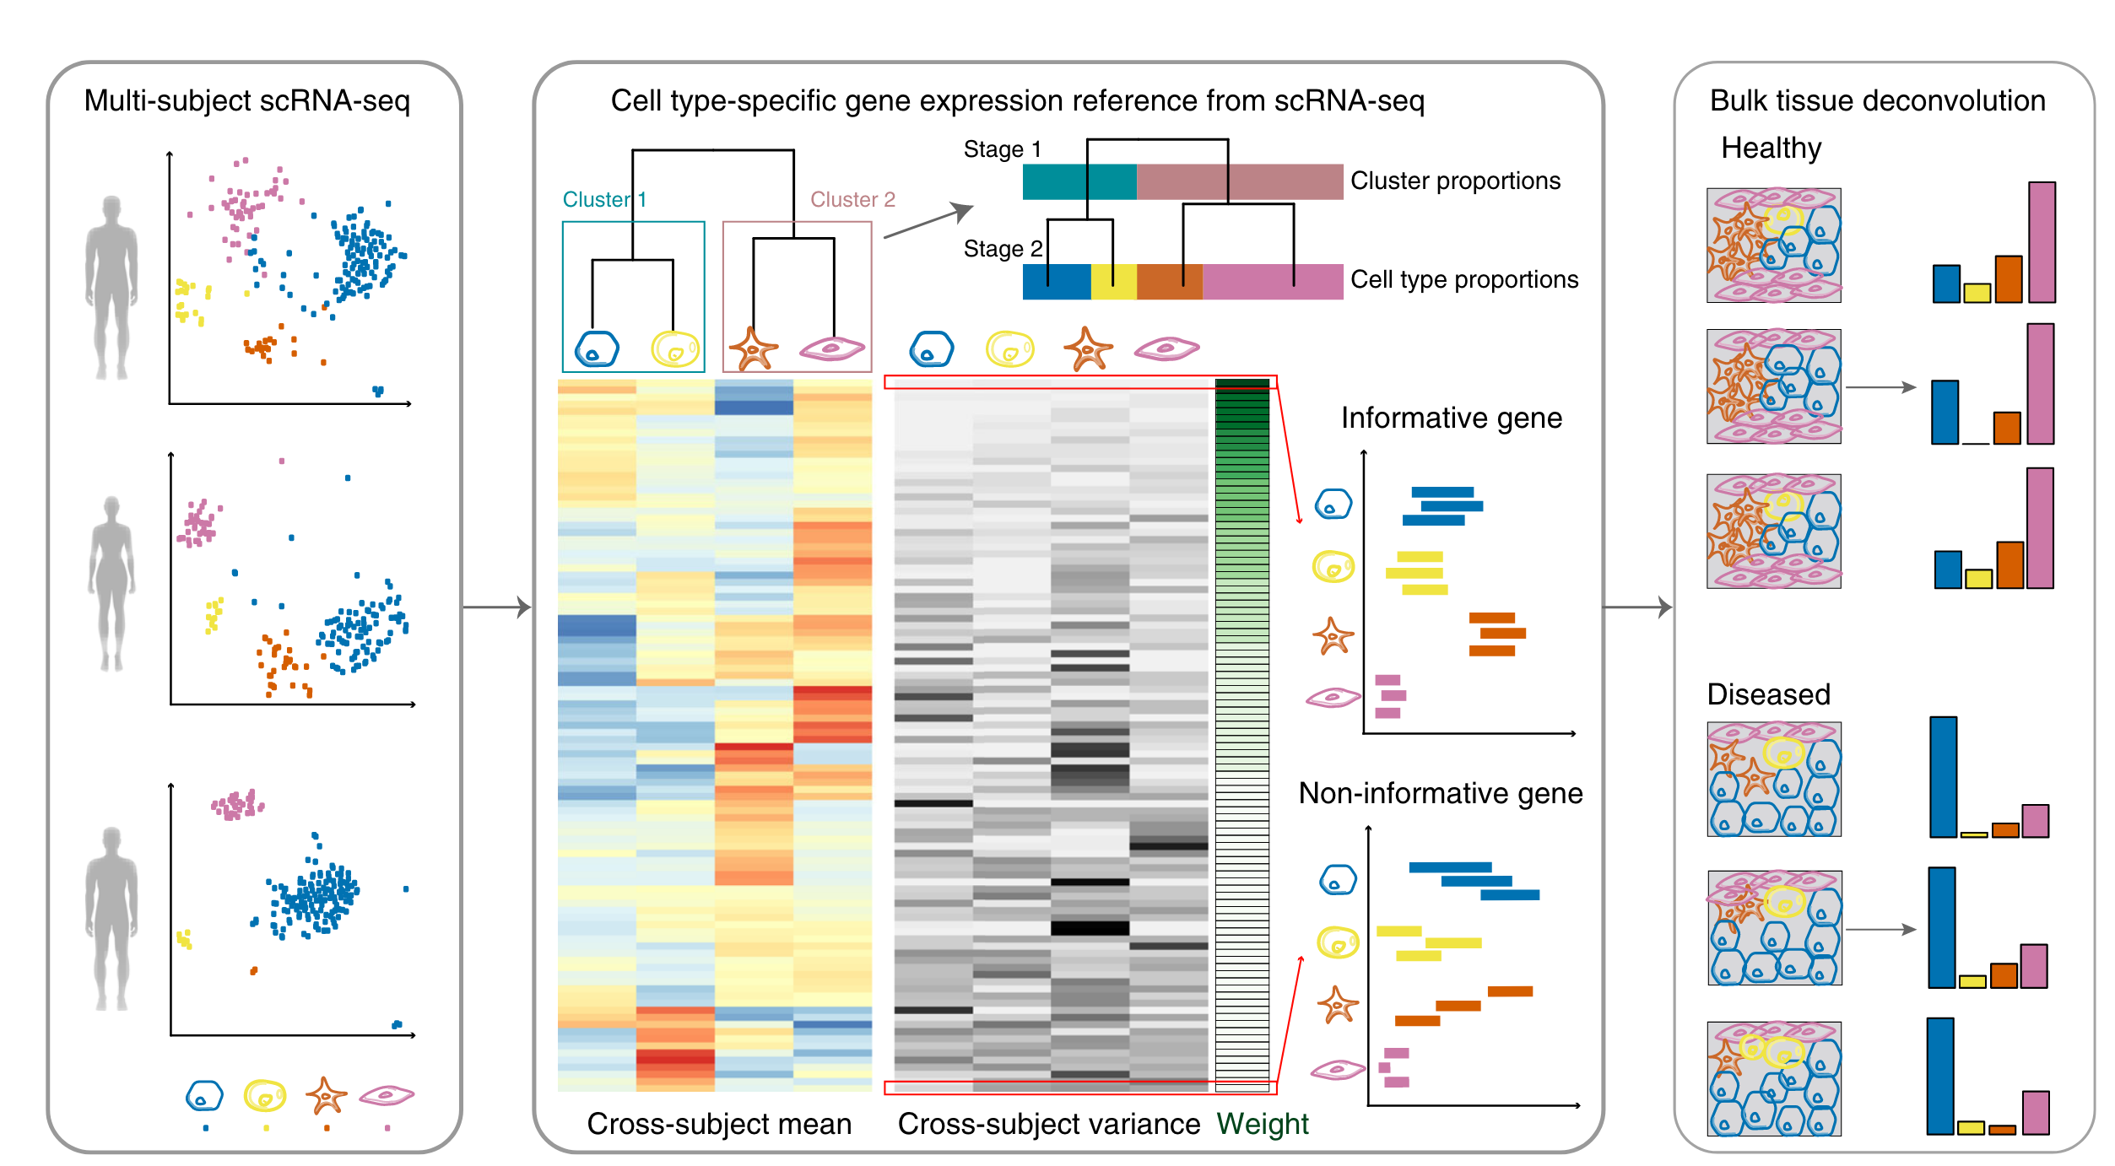
MUlti-Subject SIngle Cell deconvolution
It is a linear regression-based method.
It performs its own data normalization, effectively dealing with batch effect.
It is a weighted non-negative least squares (W-NNLS) iterative procedure up-weighs genes with low cross-subject variance and down-weighs and with less cross-cell type variations.
Notes:
Y
MUSiC determines the group-consistent genes and calculates cross-subject mean and cross-subject variance for these genes in each cell type.

Slide 17

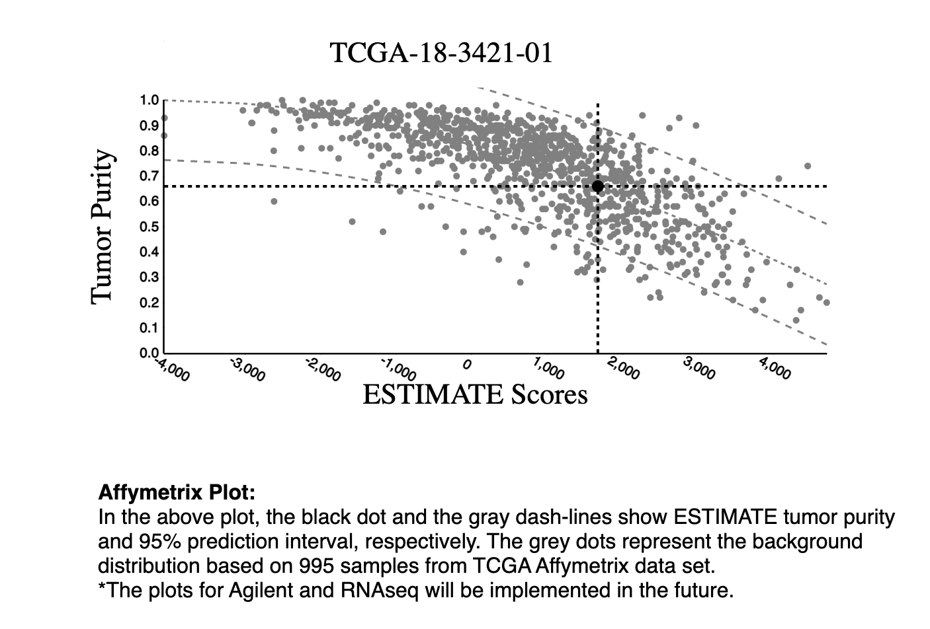

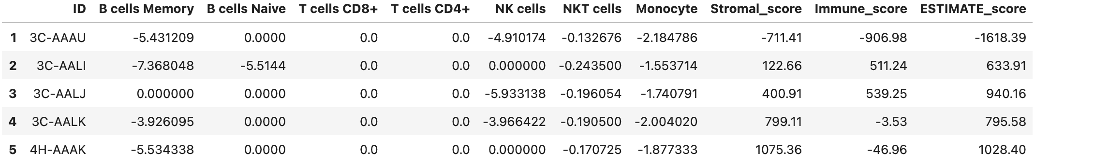
ML Model Settings
Cross-validation with hyper-parameter tuning:
kernel: gbtree, alpha: 0.01, lambda: 1
Features Importance based on Shapley value
Notes:
Y
Using expression data, ESTIMATE determines the level of stromal cells present, the infiltration level of immune cells in tumor tissues and provides a score to quantify tumor purity.

Slide 18
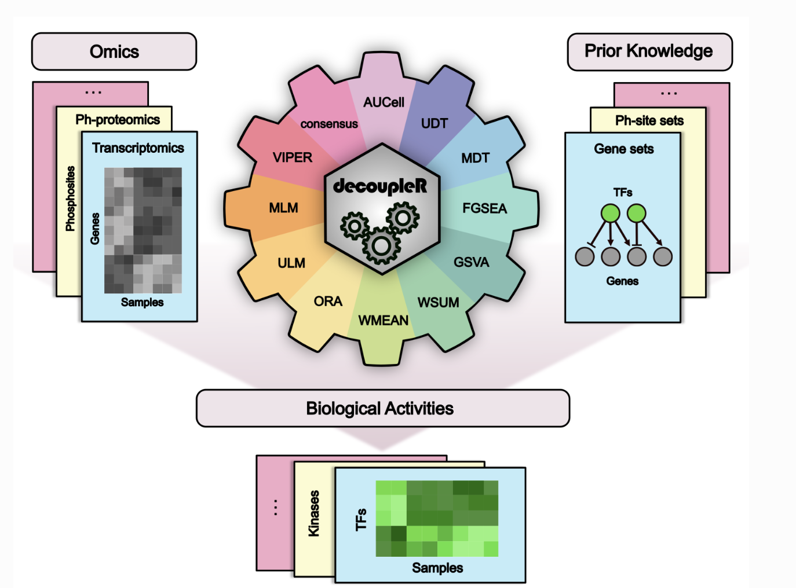
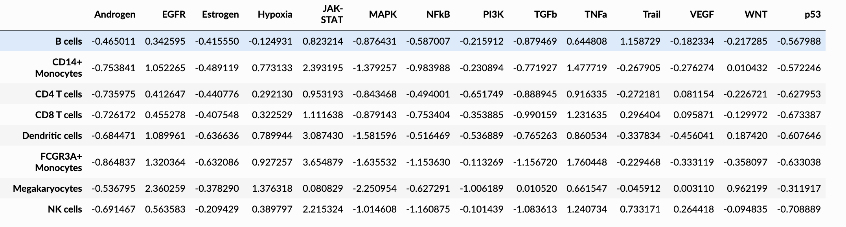
PROGENy and Decoupler for pathway activity inference
PROGENy is a list of 14 cancer related pathways and the top 100 responsive genes ranked by p-values, with their weights for each pathway.
Decoupler uses the regulator weights from PROGENy to explain the read counts and compute a consensus score which is the average of three different z-scores generated by a univariate linear model (ulm), multivariate model (mlm) and weighted sum model (wsum_norm)
Notes:
Y

Slide 19
Deconvolution Results

Slide 20
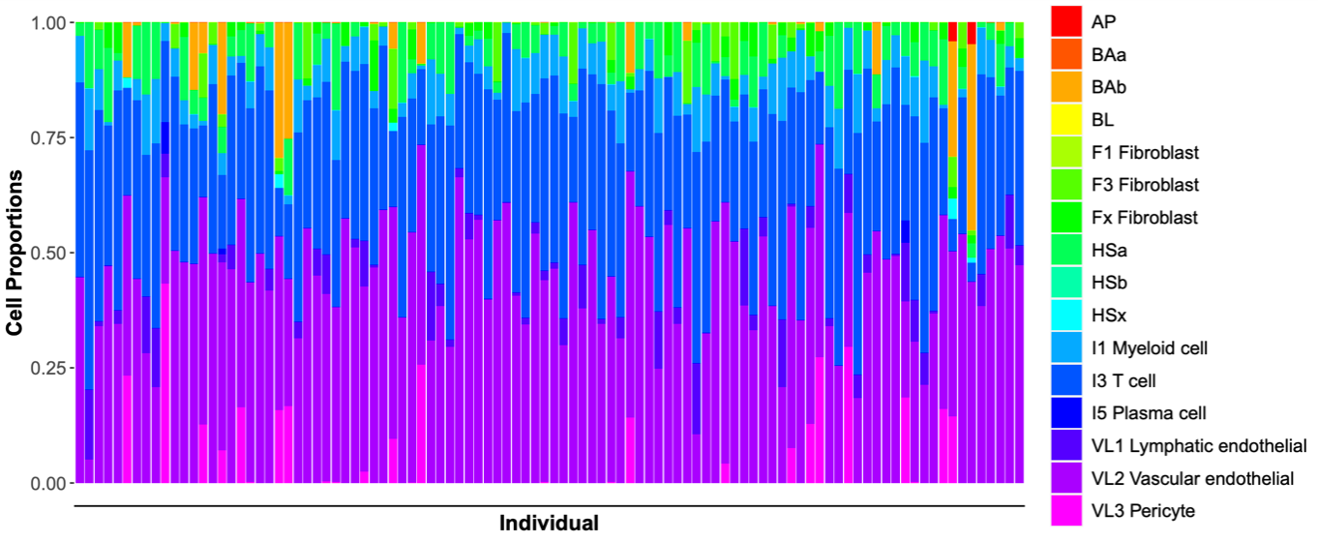
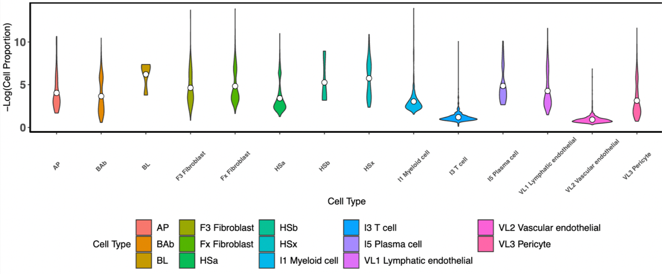
Deconvolution Results
VL2 vascular endothelial and immune I3 T cell subtypes are predominant
Levels are lower compared to HS(a,b,x) and BL cells.
Notes:
Y

Slide 21
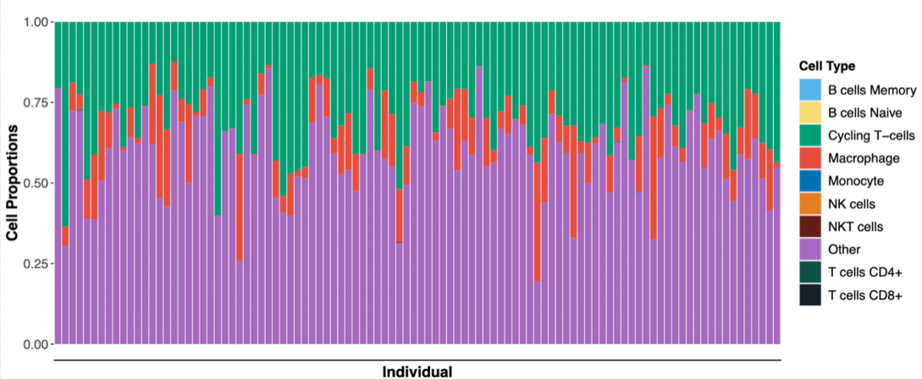
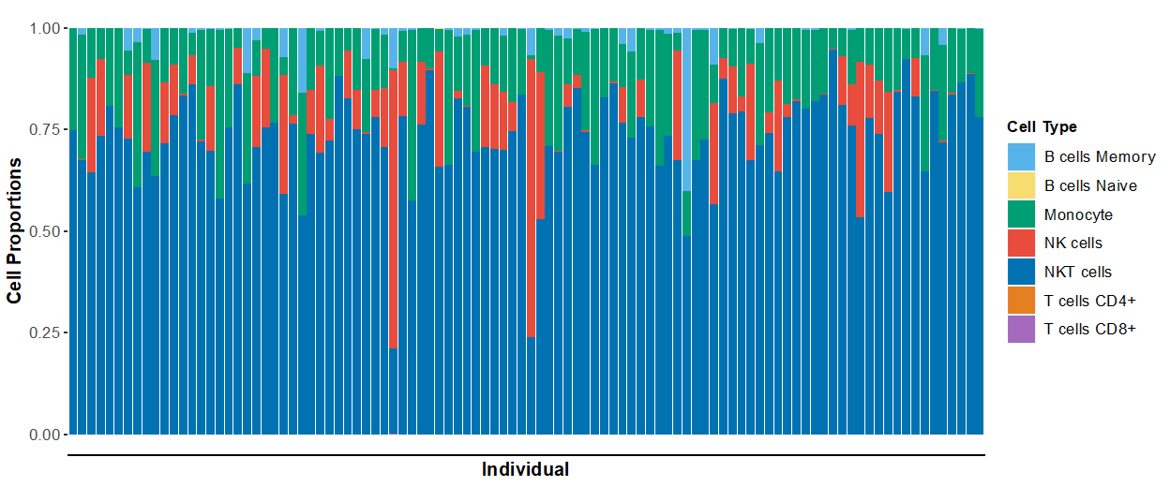
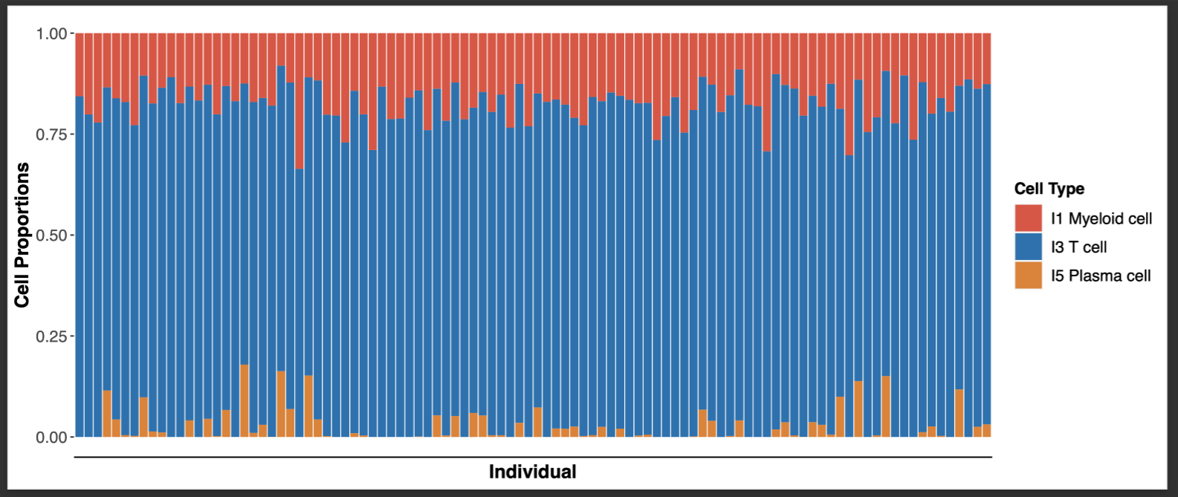
Complex interplay of different types of immune cells at play, each with its unique functions and roles in the immune response.
Notes:
y
Top: Most prevalent are Cycling T cells, and Macrophages
Middle: High number of NKT and NK cells
Bottom: T cells are predominant followed by myeloid and plasma cells
Macrophages are a type of white blood cell that plays an important role in the immune system by engulfing and digesting foreign substances, such as bacteria and viruses. They are also involved in the process of tissue repair and can produce cytokines that help to regulate the immune response.
Cycling T cells, on the other hand, are a type of T cell that rapidly divide and expand in response to an antigen.
NKT cells are a type of T cell that share some characteristics with both T cells and natural killer (NK) cells. They play a role in regulating immune responses and can quickly respond to infections. NK cells are a type of white blood cell that is important in the early defense against viruses and cancer cells. They can directly kill infected or cancerous cells and also produce cytokines that help to stimulate the immune response.
Myeloid cells are a diverse group of cells that include neutrophils, eosinophils, basophils, and monocytes, which can differentiate into macrophages and dendritic cells. Plasma cells, meanwhile, are a type of B cell that produce and secrete antibodies, which are proteins that can recognize and bind to specific antigens, marking them for destruction by other cells in the immune system.

Slide 22
Immune Score Feature Importance

Slide 23
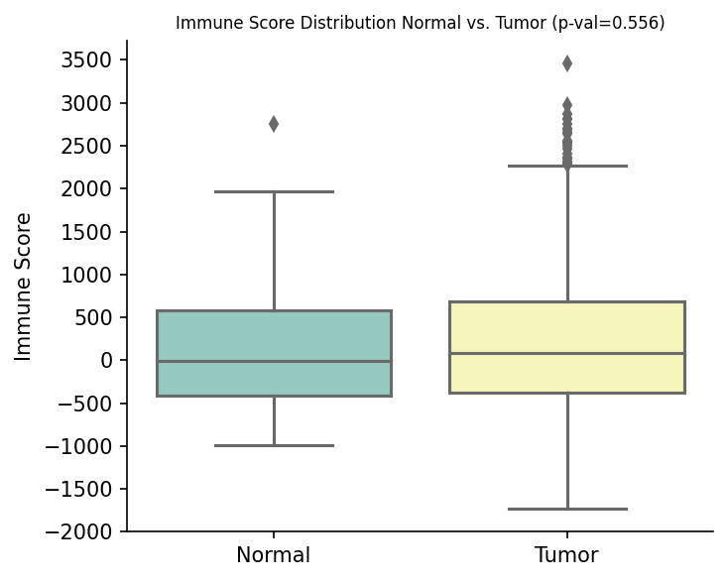
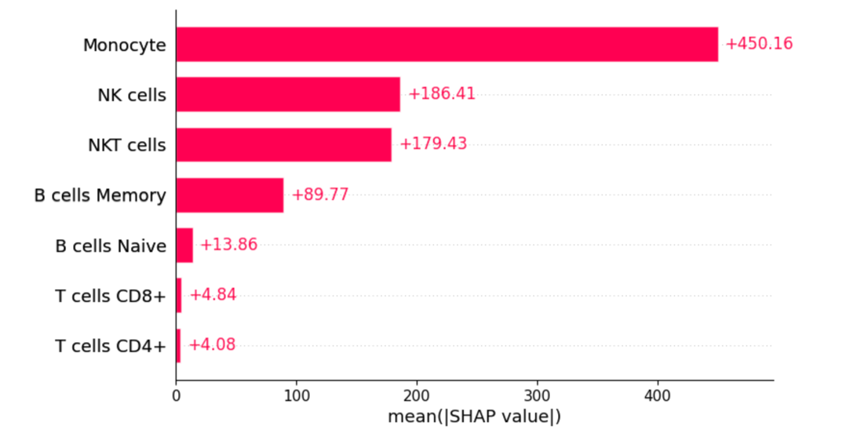
Cell Type Contribution to Immune System
Notes:
Y
Monocytes, NK, and NKT cells are the most impactful contributors to the immune score among TCGA tumor patients

Slide 24
Pathway Inference
Notes:
R

Slide 25
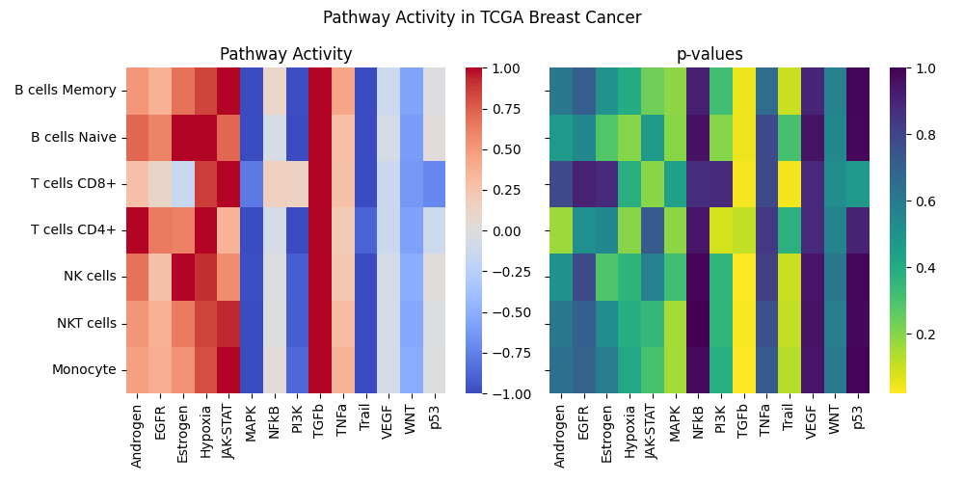
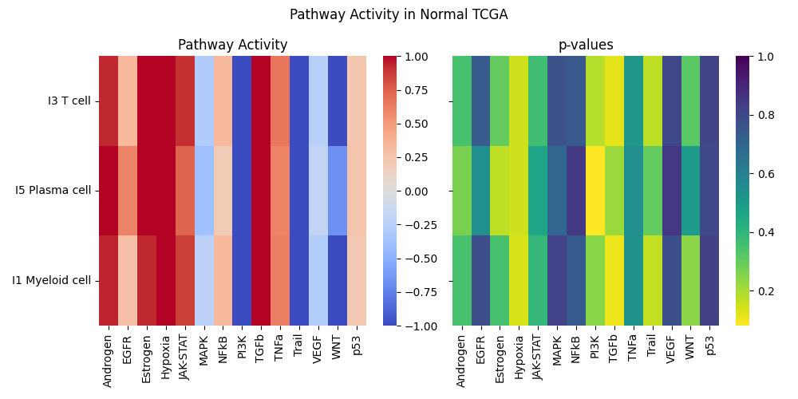
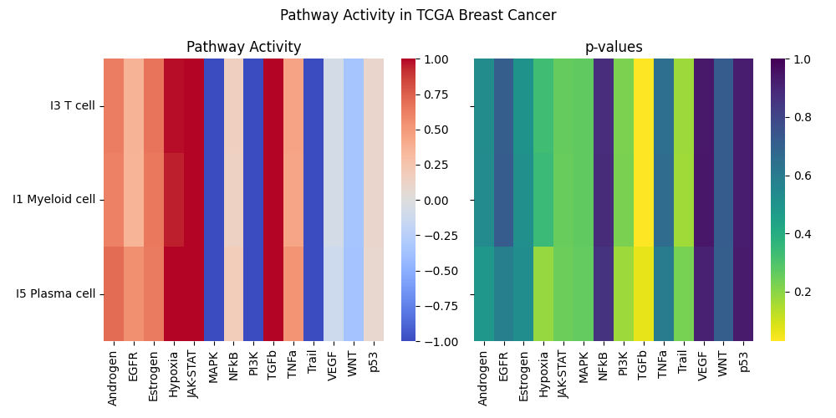
Pathway Inference
Most immune cells have high activity in transforming growth factor-β (TGF-β)
Lower activity in pathways that induce apoptosis, such as TRAIL (Tumor necrosis factor (TNF)-related apoptosis-inducing ligand), and MAPK pathway.
Potential biomarkers for breast cancer immunotherapy: ID1, ID3, COM, PMEPA1, SMAD7 (TGF-β) and RHEBL1, SMIM3, GPR18, RAB37, RNF175 (TRAIL)
Notes:
R
PROGENy: gene set enrichment analysis (GSEA) and pathway analysis of gene expression data
Decoupler: Python package
(take omics data/transcriptomics --> biological activities)
Evolutionarily conserved pathways;
-Transforming growth factor-β (TGF-β) :
Prognostic markers: genes with highest weight (most significant) from the significant pathways
Have clear biomarkers for breast cancer cells, but lacking for immune cell types
Mitogen-activated protein kinases (MAPKs
The decoupler Python package utilizes statistical methods such as Weighed Sum (WMEAN)

Slide 26
Survival Analysis
Notes:
Y

Slide 27
Survival analysis Methodology
Kaplan-Meir estimators were fitted by sorting the cell proportions in ascending order and dividing patients into high and low cell type proportions using the median
Hazard ratios, p-values and confidence intervals were obtained with semi-parametric COX models (valid when assumptions of proportionalities are not satisfied)
Notes:
Y

Slide 28
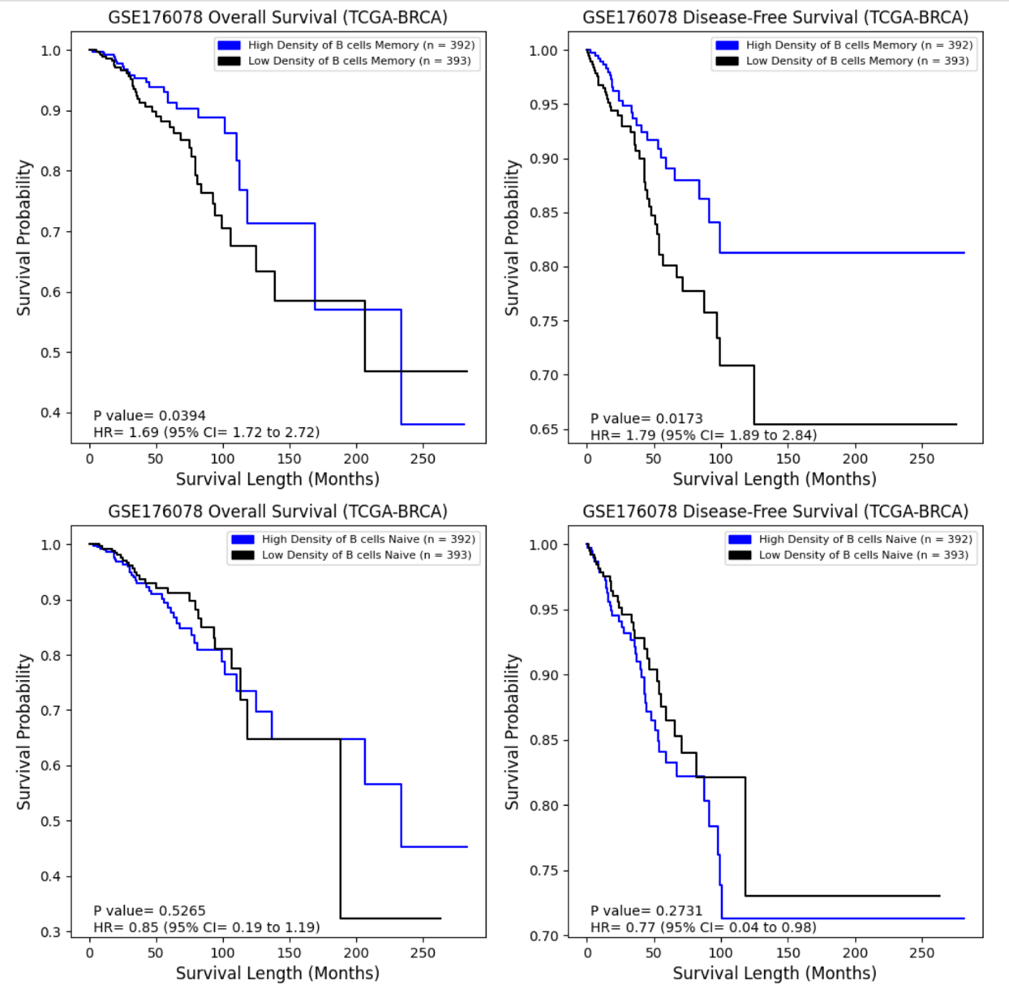
Correlation between cell type and survival outcome [1]
B cell infiltration has mostly been associated with improved prognosis in breast cancer patients.
Memory B cells more enriched in breast cancers compared to healthy tissue; consistently found to be associated with good prognosis (Li et. al; 2023).
Notes:
R
Tumor patients with high levels of memory B cells had significantly lower overall survival (OS) and significantly higher disease-free survival (DFS) when compared to patients with low levels of memory B cells.
Look up OS vs DFS
DFS =

Slide 29
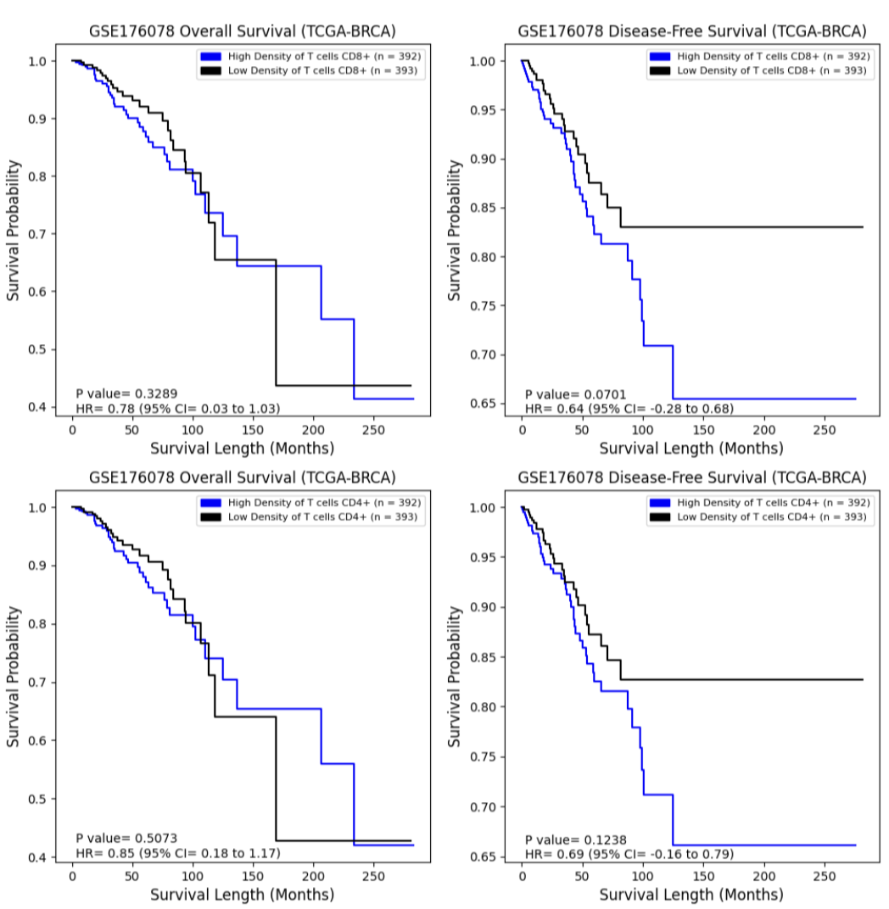
Correlation between cell type and survival outcome [2]
Notes:
R
High levels of CD8+ T cells showed lower DFS that was near significant (p-val = 0.07).

Slide 30
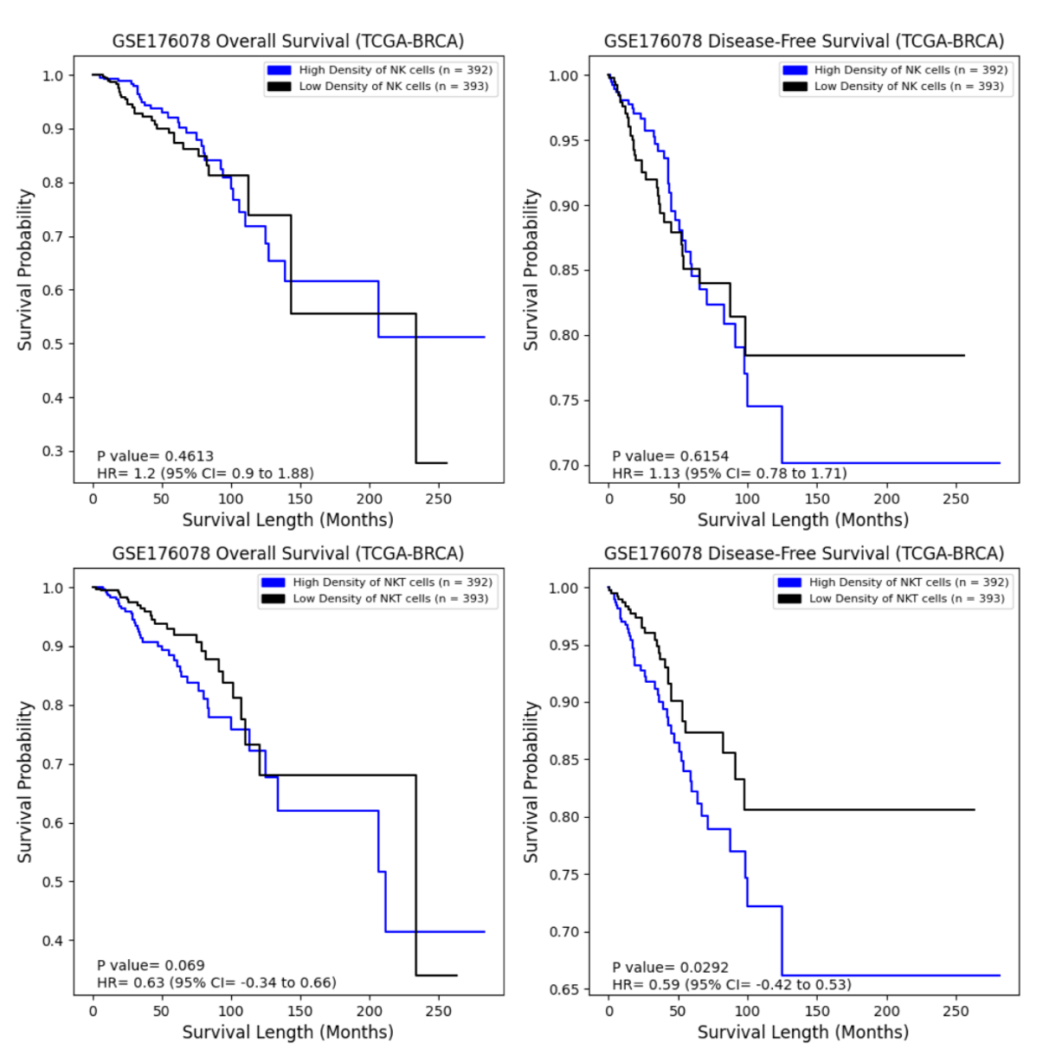
Correlation between cell type and survival outcome [3]
In breast cancer... (Liu et. Al; 2021):
NK cells are functionally impaired
NKT cells exhibit a relatively activated phenotype
Notes:
R
High levels of NKT cells had significantly lower DFS, while low levels of NKT cells showed higher OS that was near significant (p-val = 0.07)
Natural killer (NK) and natural killer T (NKT) cells are two important cell subsets of the innate immune system.
Both play role in anti-tumor immunity, but have distinct metabolomic and functional profliles during cancer development
NK cells are functionally impaired in cancers

Slide 31
Discussion and Conclusions

Slide 32
Overall...
Deconvolution shows higher proportion of immune cells in diseased vs non-diseased patients
Heterogeneity in cell composition across individuals
Results of survival analyses were conflicting, possibly supporting duality of immune cells' roles in tumors
Results of pathway inference provide insight into differences in functionality across immune cell types in diseased vs non-diseased states

Slide 33
Literature Exploration
Composition of immune cells in breast tissues progressively increases from normal to breast cancer (Goff et. al; 2021)
TRAIL (Johnstone et. Al; 2008):
An immune effector molecule that acts in surveillance and elimination of developing tumors
Escape from TRAIL-mediated immunosurveillance --> tumor onset and progression
TGFβ:
antiproliferative effects on peripheral T-cells (Chen et. Al; 2003)
blocks NK function in several different ways (Batlle et. Al; 2019)
Notes:
R
TRAIL: downregulated
TGF-β: upregulated; significantly
NK blocking by preventing cell surface receptor expression and repressing its cytotoxic activity

Slide 34
Take Home Messages
Yves: "It can be challenging to locate datasets that can precisely address our research questions, and the research must be formulated in biological terms that are answered through computational methodologies."
Reem: "In this deconvolution analysis, we attempt to simplify a busy and complex tumor microenvironment (TME). What is actually happening in each patient's heterogenous TME depends on crosstalk between the immune cell types and subtypes, and crosstalk between pathways within each cell type."
Lingzhu: Various cells and cytokines have an impact on the progression of tumors, which makes the tumor microenvironment highly complex. Studying the combined action of immune cells and cytokines can help us better understand the mechanisms of tumor progression.
Notes:
R, Y, L
R: sysems biology to actually get a more comprehensive analysis

Slide 35


Slide 36
References
“Cancer Survival Statistics: World Cancer Research Fund International.” WCRF International, 11 July 2022, https://www.wcrf.org/cancer-trends/cancer-survival-statistics/.
Gray, G. K., Li, C. M., Rosenbluth, J. M., Selfors, L. M., Girnius, N., Lin, J. R., Schackmann, R. C. J., Goh, W. L., Moore, K., Shapiro, H. K., Mei, S., D'Andrea, K., Nathanson, K. L., Sorger, P. K., Santagata, S., Regev, A., Garber, J. E., Dillon, D. A., & Brugge, J. S. (2022). A human breast atlas integrating single-cell proteomics and transcriptomics. Developmental cell, 57(11), 1400–1420.e7. https://doi.org/10.1016/j.devcel.2022.05.003
Fan, J., Lyu, Y., Zhang, Q., Wang, X., Li, M., & Xiao, R. (2022). MuSiC2: cell-type deconvolution for multi-condition bulk RNA-seq data. Briefings in bioinformatics, 23(6), bbac430. https://doi.org/10.1093/bib/bbac430
Huang, Ruichao, et al. “Combining Bulk RNA-Sequencing and Single-Cell RNA-Sequencing Data to Reveal the Immune Microenvironment and Metabolic Pattern of Osteosarcoma.” Frontiers in Genetics, vol. 13, Oct. 2022, p. 976990. DOI.org (Crossref), https://doi.org/10.3389/fgene.2022.976990.
Lai, Wenwen, et al. “Integrated Analysis of Single‐cell RNA‐seq Dataset and Bulk RNA‐seq Dataset Constructs a Prognostic Model for Predicting Survival in Human Glioblastoma.” Brain and Behavior, vol. 12, no. 5, Apr. 2022, p. e2575. PubMed Central, https://doi.org/10.1002/brb3.2575.
Manoharan, Malini, et al. “A Computational Approach Identifies Immunogenic Features of Prognosis in Human Cancers.” Frontiers in Immunology, vol. 9, Dec. 2018, p. 3017. PubMed Central, https://doi.org/10.3389/fimmu.2018.03017.
Qi, Zongtai, et al. “Single-Cell Deconvolution of Head and Neck Squamous Cell Carcinoma.” Cancers, vol. 13, no. 6, Mar. 2021, p. 1230. DOI.org (Crossref), https://doi.org/10.3390/cancers13061230.
Gonzalez, H., Hagerling, C., & Werb, Z. (2018). Roles of the immune system in cancer: from tumor initiation to metastatic progression. Genes & development, 32(19-20), 1267–1284. https://doi.org/10.1101/gad.314617.118
Man, Y. G., Stojadinovic, A., Mason, J., Avital, I., Bilchik, A., Bruecher, B., Protic, M., Nissan, A., Izadjoo, M., Zhang, X., & Jewett, A. (2013). Tumor-infiltrating immune cells promoting tumor invasion and metastasis: existing theories. Journal of Cancer, 4(1), 84–95. https://doi.org/10.7150/jca.5482
McDonald, K. A., Kawaguchi, T., Qi, Q., Peng, X., Asaoka, M., Young, J., Opyrchal, M., Yan, L., Patnaik, S., Otsuji, E., & Takabe, K. (2019). Tumor Heterogeneity Correlates with Less Immune Response and Worse Survival in Breast Cancer Patients. Annals of surgical oncology, 26(7), 2191–2199. https://doi.org/10.1245/s10434-019-07338-3
Orrantia-Borunda E, Anchondo-Nuñez P, Acuña-Aguilar LE, Gómez-Valles FO, Ramírez-Valdespino CA. Subtypes of Breast Cancer. In: Mayrovitz HN. editor. Breast Cancer. Brisbane (AU): Exon Publications. Online first 22 Jun 2022.
Wu, S. Z., Al-Eryani, G., Roden, D. L., Junankar, S., Harvey, K., Andersson, A., Thennavan, A., Wang, C., Torpy, J. R., Bartonicek, N., Wang, T., Larsson, L., Kaczorowski, D., Weisenfeld, N. I., Uytingco, C. R., Chew, J. G., Bent, Z. W., Chan, C. L., Gnanasambandapillai, V., Dutertre, C. A., … Swarbrick, A. (2021). A single-cell and spatially resolved atlas of human breast cancers. Nature genetics, 53(9), 1334–1347. https://doi.org/10.1038/s41588-021-00911-1
Pal, B., Chen, Y., Vaillant, F., Capaldo, B. D., Joyce, R., Song, X., Bryant, V. L., Penington, J. S., Di Stefano, L., Tubau Ribera, N., Wilcox, S., Mann, G. B., kConFab, Papenfuss, A. T., Lindeman, G. J., Smyth, G. K., & Visvader, J. E. (2021). A single-cell RNA expression atlas of normal, preneoplastic and tumorigenic states in the human breast. The EMBO journal, 40(11), e107333. https://doi.org/10.15252/embj.2020107333
De Silva, D., Kunasegaran, K., Ghosh, S., & Pietersen, A. M. (2015). Transcriptome analysis of the hormone-sensing cells in mammary epithelial reveals dynamic changes in early pregnancy. BMC developmental biology, 15, 7. https://doi.org/10.1186/s12861-015-0058-9
Gusterson, B., & Eaves, C. J. (2018). Basal-like Breast Cancers: From Pathology to Biology and Back Again. Stem cell reports, 10(6), 1676–1686. https://doi.org/10.1016/j.stemcr.2018.04.023
https://journals.plos.org/plosone/article?id=10.1371/journal.pone.0280851#pone.0280851.ref008
Zitvogel, L., Tesniere, A. & Kroemer, G. Cancer despite immunosurveillance: immunoselection and immunosubversion. Nat Rev Immunol 6, 715–727 (2006). https://doi.org/10.1038/nri1936
Goff, S. L., & Danforth, D. N. (2021). The Role of Immune Cells in Breast Tissue and Immunotherapy for the Treatment of Breast Cancer. Clinical breast cancer, 21(1), e63–e73. https://doi.org/10.1016/j.clbc.2020.06.011
Bhat-Nakshatri P, Gao H, Sheng L, McGuire PC, Xuei X, Wan J, Liu Y, Althouse SK, Colter A, Sandusky G, Storniolo AM, Nakshatri H. A single-cell atlas of the healthy breast tissues reveals clinically relevant clusters of breast epithelial cells. Cell Rep Med. 2021 Mar 16;2(3):100219. doi: 10.1016/j.xcrm.2021.100219. PMID: 33763657; PMCID: PMC7974552.
Gonzalez, H., Hagerling, C., & Werb, Z. (2018). Roles of the immune system in cancer: from tumor initiation to metastatic progression. Genes & development, 32(19-20), 1267–1284. https://doi.org/10.1101/gad.314617.118
Shen, M., Wang, J., & Ren, X. (2018). New Insights into Tumor-Infiltrating B Lymphocytes in Breast Cancer: Clinical Impacts and Regulatory Mechanisms. Frontiers in immunology, 9, 470. https://doi.org/10.3389/fimmu.2018.00470
Chen, C. H., Seguin-Devaux, C., Burke, N. A., Oriss, T. B., Watkins, S. C., Clipstone, N., & Ray, A. (2003). Transforming growth factor β blocks Tec kinase phosphorylation, Ca2+ influx, and NFATc translocation causing inhibition of T cell differentiation. The Journal of experimental medicine, 197(12), 1689-1699.
Batlle E, Massagué J. Transforming Growth Factor-β Signaling in Immunity and Cancer. Immunity. 2019 Apr 16;50(4):924-940. doi: 10.1016/j.immuni.2019.03.024. PMID: 30995507; PMCID: PMC7507121.
Staal, F., Luis, T. & Tiemessen, M. WNT signalling in the immune system: WNT is spreading its wings. Nat Rev Immunol 8, 581–593 (2008). https://doi.org/10.1038/nri2360
Liu, Y., Shepherd, E. & Nelin, L. MAPK phosphatases — regulating the immune response. Nat Rev Immunol 7, 202–212 (2007). https://doi.org/10.1038/nri2035
Debien, V., De Caluwé, A., Wang, X. et al. Immunotherapy in breast cancer: an overview of current strategies and perspectives. npj Breast Cancer 9, 7 (2023). https://doi.org/10.1038/s41523-023-00508-3
Galli, F., Aguilera, J.V., Palermo, B. et al. Relevance of immune cell and tumor microenvironment imaging in the new era of immunotherapy. J Exp Clin Cancer Res 39, 89 (2020). https://doi.org/10.1186/s13046-020-01586-y
Johnstone, R., Frew, A. & Smyth, M. The TRAIL apoptotic pathway in cancer onset, progression and therapy. Nat Rev Cancer 8, 782–798 (2008). https://doi.org/10.1038/nrc2465
Liu, X., Li, L., Si, F. et al. NK and NKT cells have distinct properties and functions in cancer. Oncogene 40, 4521–4537 (2021). https://doi.org/10.1038/s41388-021-01880-9
Li, M., Quintana, A., Alberts, E., Hung, M. S., Boulat, V., Ripoll, M. M., & Grigoriadis, A. (2023). B Cells in Breast Cancer Pathology. Cancers, 15(5), 1517. https://doi.org/10.3390/cancers15051517

Slide 37
EXTRA

Slide 38
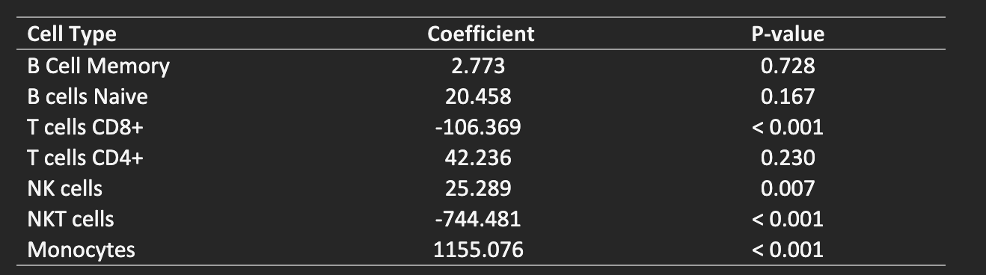
XGBoost Model Coefficients and p-values

Slide 39
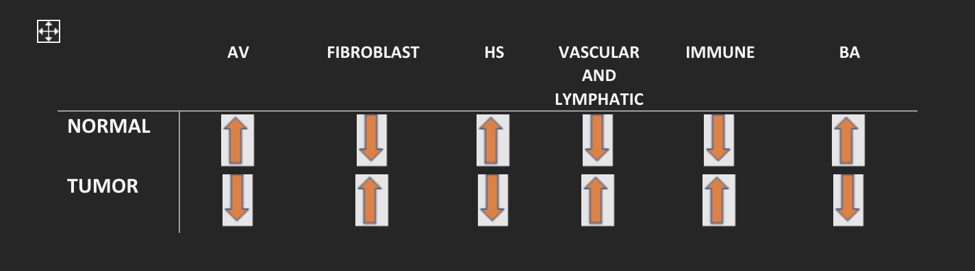
Cell Type Control vs. Experimental Cohort

